Slide 1
Module 1 Introduction to the HAIL Program
This module explains the importance of the HAIL program and some key concepts

Slide 2
Module 1
Learning Outcomes
To learn what HAIL is and how:
---It can help consumers
---It can enhance the work of CIL staff
To understand the concepts of:
---Health Disparities
---Secondary Conditions
---Preventive Care

Slide 3
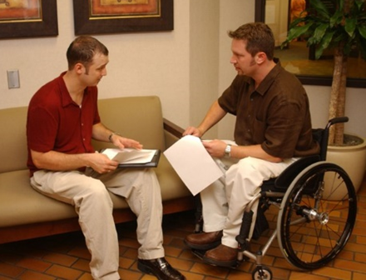
Contents
What is HAIL ?
What is the purpose of HAIL?
Understanding:
---Health Disparities ---Secondary Conditions ---Preventive Care

Slide 4
What is HAIL?
It’s a health management tool for people with mobility-related disability to address:
The role of depression, fatigue and pain, as barriers to community living and participation
The need for support to build consumer skills to access health care and manage personal health
Notes:
Since CIL staff confirmed the need for a health promotion tool, we designed one called HAIL (Health Access for Independent Living)

Slide 5
Why HAIL?
To develop a health management tool that supports CIL staff in assisting consumers to set and achieve short-term health goals to enhance independent living, so consumers can:
Experience fewer chronic condition complications, secondary conditions, and hospitalizations
Avoid institutionalization
Increase ability to participate in the community
Be better managers of their health
Be more informed users of health care services
Notes:
Comments from reviewers: One reviewer commented that this program is “…..long overdue and gives more than enough information for centers( and consumers) to make an informed decision”
to aid CIL consumers with mobility-related disabilities manage their health

Slide 6
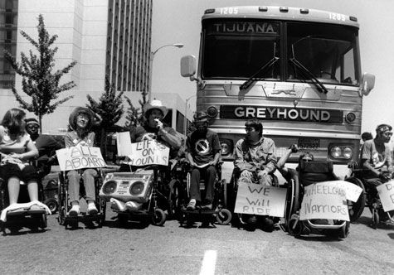
Health Disparities
Health Disparities are preventable differences in optimal health experienced by socially disadvantaged populations. These disadvantages include:
Poverty
Geographic location
Disability
Race/ethnicity
Lack of education
Inadequate healthcare
Health Disparities are caused when there is unequal distribution of resources such as political, social, economic, and environmental resources.
Notes:
Since CIL staff confirmed the need for a health promotion tool, we designed one called HAIL (Health Access for Independent Living)

Slide 7
Evidence of Health Disparities
Some commonly found evidence of health disparities experienced by people with disabilities are: ▪ inaccessible physical environments; ▪ unaccommodating policies and procedures; ▪ inaccurate assumptions about the abilities and rights of people with disabilities;
These can result in inferior health care, ill health, institutionalization and premature death for people with disabilities.
Notes:
Comments from reviewers: One reviewer commented that this program is “…..long overdue and gives more than enough information for centers( and consumers) to make an informed decision”
to aid CIL consumers with mobility-related disabilities manage their health

Slide 8
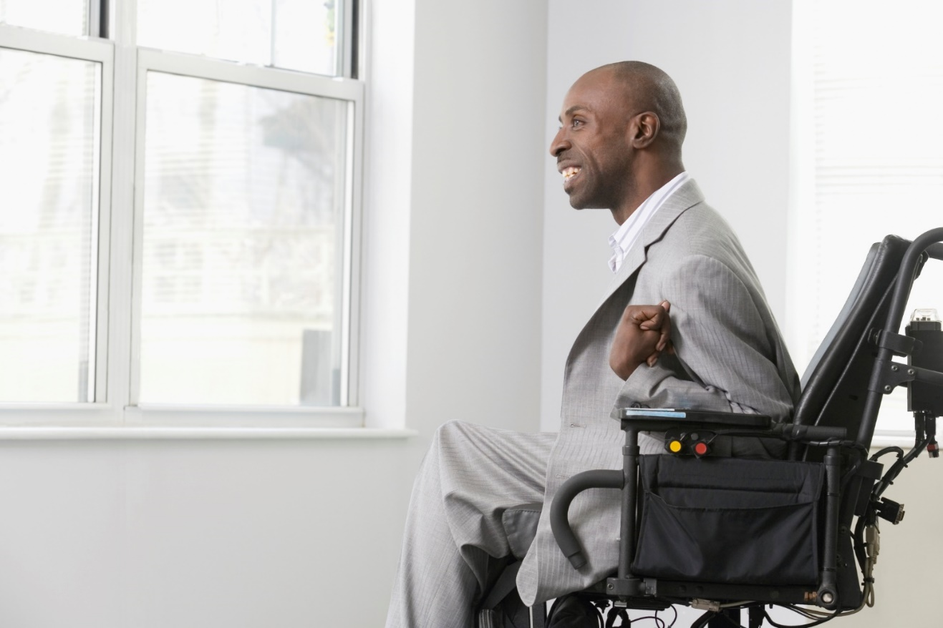
Secondary Conditions
People with disabilities often are at greater risk for health problems that can be prevented. As a result of having a disability, such as a spinal cord injury, blindness, or epilepsy, an additional physical or mental health condition can occur. Sometimes these conditions are more serious or life-threatening then the primary disability.

Slide 9
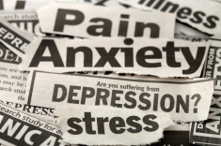
Examples of Secondary Conditions
These conditions are called secondary conditions, because they are secondary to a primary disability, and might include:
Bowel or bladder problems
Fatigue
Injury
Depression
Overweight and obesity
Pain
Medication problems

Slide 10
Common Secondary Conditions
Some examples of common secondary conditions:
▪ a pressure ulcer in a person with limited sensation due to paraplegia ▪ a burn experienced by a person who is blind ▪ medication side-effects experienced by a person with epilepsy ▪ depression experienced by a person with any type of disability.
It’s important to remember that secondary conditions are preventable, so both patients and health care providers should take them seriously and work to prevent or find a remedy for them.

Slide 11
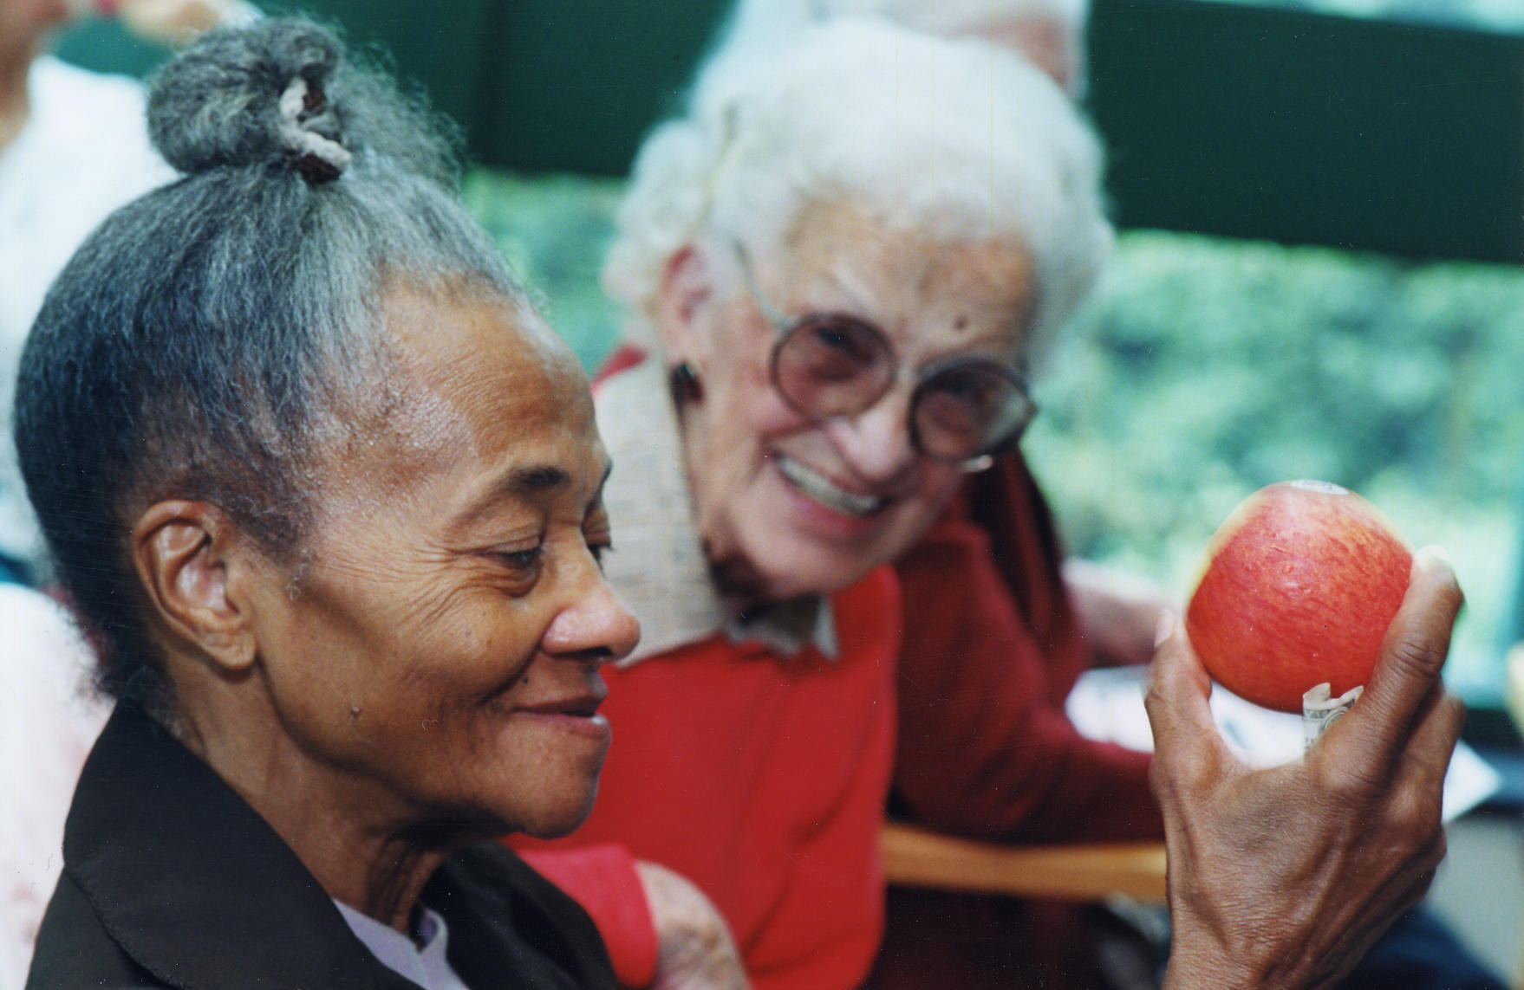
What is Preventive Care?
Preventive health care means doing things to prevent disease from occurring or catching it early, versus doing things to treat disease.
So, for example , it means getting a flu shot to keep from getting the flu (prevention), versus taking medications to reduce symptoms once you get the flu (treatment).

Slide 12
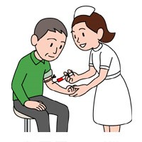
Why is Preventive Health Care Important?
People can have a positive effect on their own health.
People with disabilities can be healthy.
People are better managers of their health when they play an active role in it.
An important factor in playing an active role in managing health is obtaining preventive health care. HAIL can help with that!

Slide 13
How do I get Preventive Health Care?
Preventive health care is different for everyone, based on things such as their age and risk factors. For example: ▪ People over 65 should be vaccinated for pneumonia. ▪ Women who have a history of breast cancer in their family, should begin getting screened through mammograms before age 40, the typical age to begin getting them.
See the HAIL fact sheet titled “Accessing Preventive Care” for more information!

Slide 14
Let’s Talk!
What barriers do your consumers encounter in accessing preventive health care?
How can you assist them in overcoming these barriers?
How can CIL staff address health disparities experienced by their consumers?
What are some of the secondary conditions facing your consumers?
What types of preventive care do your consumers receive?

Slide 15
Any Questions?

